Slide 1
On-Line Personal Branding
Tips and Tricks to Managing Your
Virtual Portfolio
Presented by: Monica Powell, PhD, Senior Associate Dean
(Inspired by http://www.slideshare.net/caturpw/an-online-personal-branding-strategy-through-social-media)

Slide 2
Objectives
It is a Social Media Revolution
Branding – What is it?
Importance of building an on-line brand
Building a “virtual” brand in an on-line world
On-line branding steps and assets
Using on-line branding to land your dream job

Slide 3
Social Media Revolution
“Social Media is any tool or service that uses the Internet to facilitate conversations.”
Brian Soles commenting on the book “ENGAGE”

Slide 4
JUST A FEW OF THE SOCIAL MEDIA SITES AVAILABLE

Slide 5
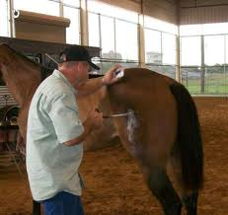
What is a BRAND?
BRAND is the IDENTITY
of a product or service.

Slide 6
What is a BRANDING?
BRANDING is
about DIFFERENTIATING yourself
from the competition and
to get noticed by your
target market.

Slide 7
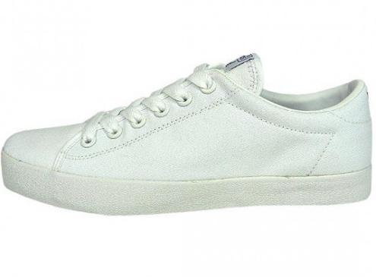

Slide 8
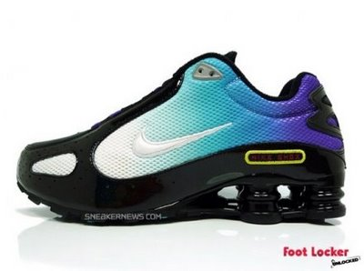

Slide 10
Reasons for Building an On-Line Brand
It is always accessible and available
It can always be modified
It sells many aspects of who you are and what you can and have done
It reinforces your value
It sells people and employers on YOU even when you aren’t present
It connects YOU to people and employers who may need someone with your talents and gifts

Slide 12
Developing Your Own Brand -------From a high level
What distinguishes you?
What makes you different? Perform a SWOT on yourself.
Develop your brand on paper FIRST
Apply brand to the rest of your career tools
THEN ----- Develop your brand on-line

Slide 13
Remember to Brand Your WHOLE Toolkit
Apply your brand to
Your resume
Your business card
Your example cover letters
Your email address
Your wardrobe

Slide 14
On-Line Brand Building Steps
Answer some critical questions
What are your goals, values and identity?
What sets you apart and gets people talking?
How do you add value to others?
What is your personal theme
Be Clear on your identity package
How will you use your name (whole, nickname)
How will people contact you (email, webpage)
How will you package your identity markers (your personal style, your speaking style, your presentations and even your website)

Slide 15
On-Line Brand Building Steps
Be Honest About Who You are
What skills do you have?
What’s your mantra?
What should employers consider you?
What problems can you solve?
Be Visible
Online and Offline
Recheck your offline documents to insure the integration is consistent
Be consistent in what your present in both places

Slide 16
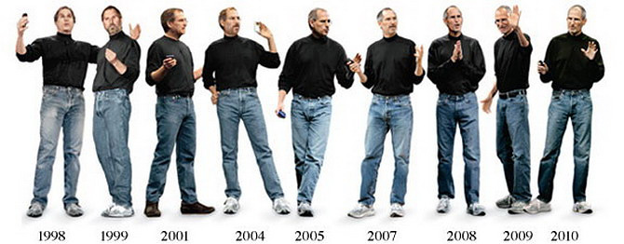

Slide 17
REMEMBER THE 80/20 RULE
80% OF JOBS ARE SECURED THROUGH NETWORKING WHILE ONLY 20% OF THE JOB ARE OBTAINED BY APPLYING ONLINE.
USE YOUR ONLINE ASSETS TO HELP YOU NETWORK MORE EFFECTIVELY!

Slide 18
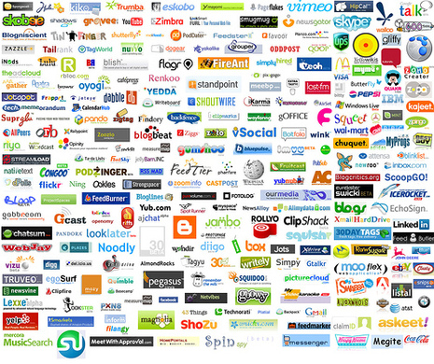
On-Line Assets
HUNDREDS OF SOCIAL
SITES ARE AVAILABLE ONLINE.
PICK THOSE THAT FIT YOUR BRAND AND YOUR IDENTITY.
START SMALL AND GROW YOUR ONLINE PRESENCE.

Slide 19
ESTABLISH YOUR OWN WEBPAGE AT UTDALLAS.EDU

Slide 20
Most Popular
Facebook
Linked-In
Twitter
Mybloglog
Youtube
Flickr
Digg
Zimbio
The more online assets you develop using a consistent and well-defined brand – the greater your chances for networking and career opportunities.

Slide 21
Online Asset Plan
Make sure you have developed a strong brand
Audit any current online assets
Choose those assets that fit with who you are and with your portfolio of skills
Develop each asset – one at a time – making sure that you are consistent in how you present your brand
Seek out friends who are asset experts
Promote your online brand

Slide 22
The Dreaded AUDIT
Example: FACEBOOK
Insure that the items that describe you are consistent with your new brand
Eliminate all photos that don’t support that brand
Choose one photo of you that you will use on all online sites
Make sure that your name is consistent with how you want to be known
Check for all misspelled, poor grammar and opinionated narratives
Alter, change or develop email addresses that are supporting the brand
Eliminate all items that might degrade your brand
Audit a friend’s brand and have them audit yours.

Slide 23
Online Asset Plan
Make sure you have developed a strong brand
Audit any current online assets (go to Audit)
Choose those assets that fit with who you are and with your portfolio of skills
Develop each asset – one at a time – making sure that you are consistent in how you present your brand
Seek out friends who are asset experts
Promote your online brand

Slide 24
Action Items and Looking Ahead
Keep a spreadsheet of your assets
Periodically update your sites
Learn how to connect your online assets (like smoreme.com and hootsuite.com)
Promote your online assets
Learn from social media leaders (Evian Roller Baby)
Look ahead to what’s next – Visual CV

Slide 25
VISUAL CV

Slide 26
Takeaways
Building an online presence takes lots of time and patience
Really define your brand before starting the process
Start small and seek out experts
Remember to link your efforts together in a meaningful way
The more you network online – the more successful your job hunt will be

